Slide 1
Data Mining Final Project: Analyzing NBA Stats
Hang Xu

Slide 2

Introduction
NBA: National Basketball Association
2 conferences, 6 divisions, 30 teams
NBA stats:
http://stats.nba.com

Slide 3
Data Collection
API:
Inherited from NBAStats API, created by Bradley Fray.
Modified by Lucas.
* Interesting fact: The original author of this API, Bradley, replied and thank me after I send a merge request to his repo on github.

Slide 4

Hypothesis
What is the influence of height of players to his performance in NBA?

Slide 5
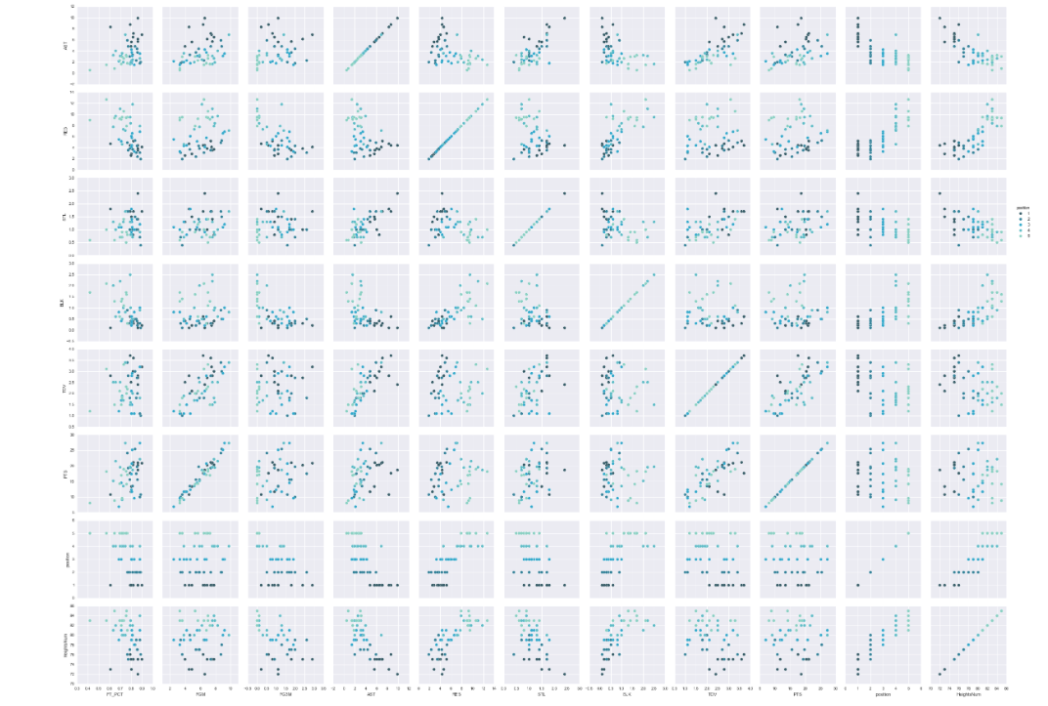

Slide 6
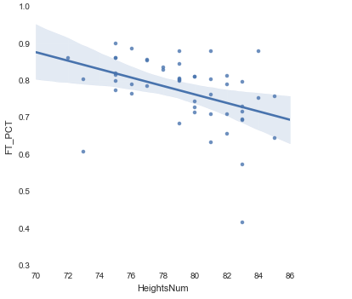
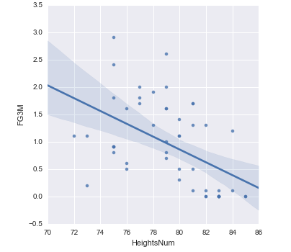
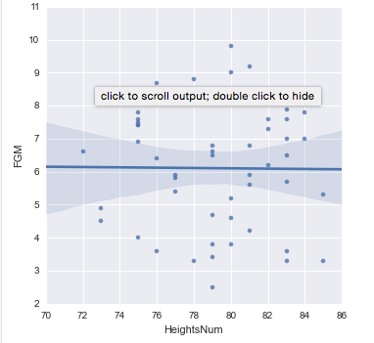
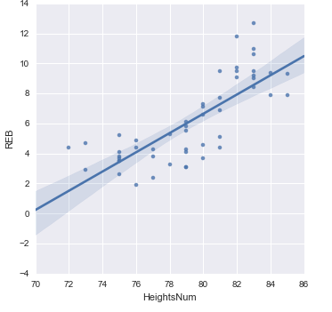

Slide 7
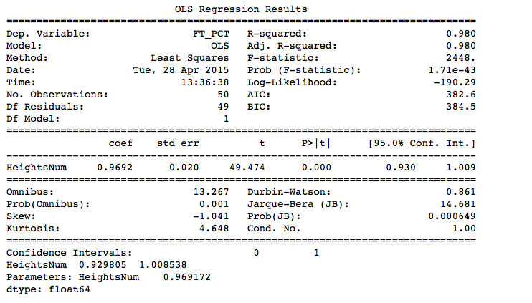
Analysis
A method for estimating the unknown parameters in a linear regression model

Slide 8

Hypothesis
2. Does winning games of a team always have the same behaviors?

Slide 9
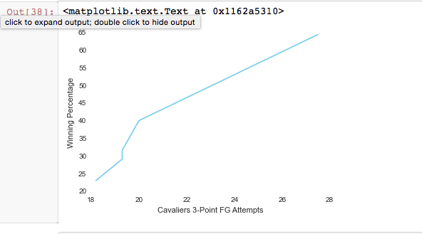
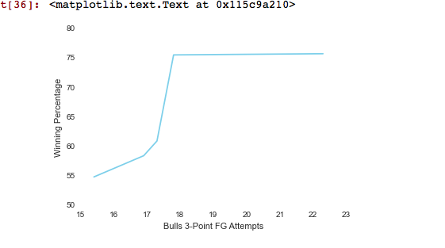
Analysis con’t

Slide 10
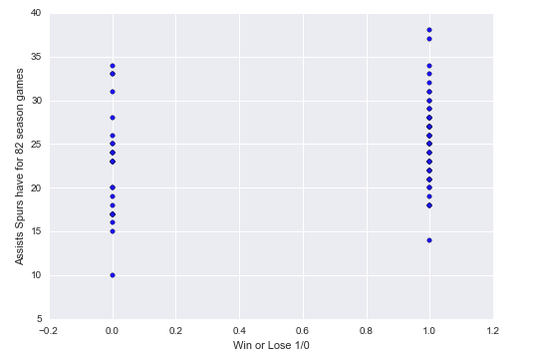
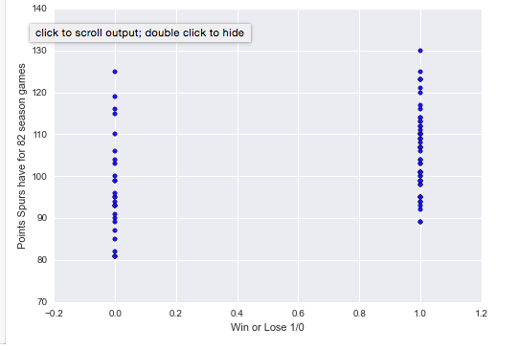
Analysis con’t

Slide 11
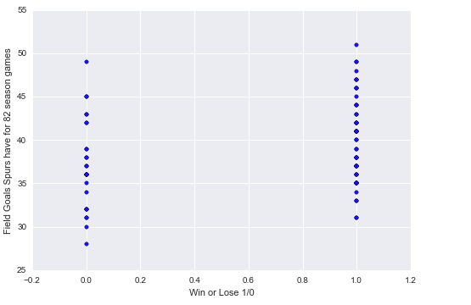
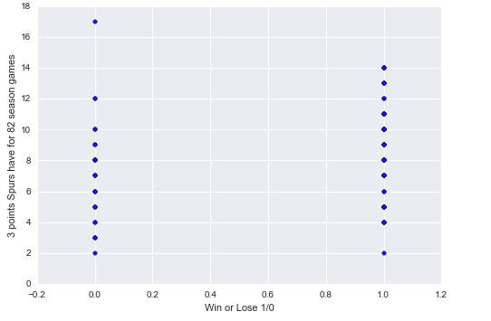
Analysis con’t

Slide 12
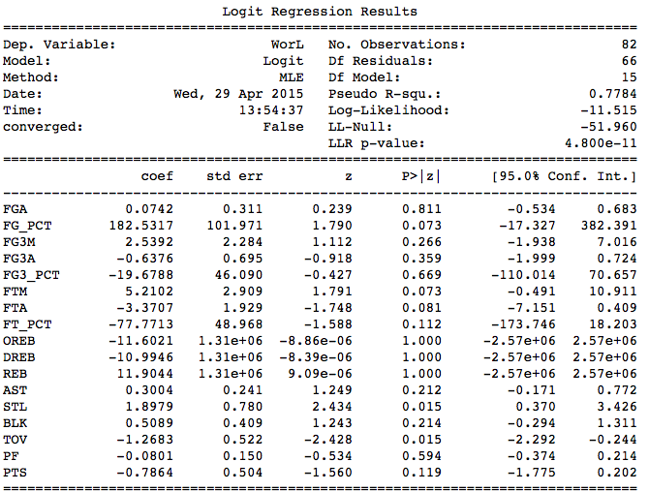
Logit Regression:
The binary logistic model is used to predict a binary response based on one or more predictor variables (features).

Slide 13
Conclusion
This is correlation between heights and many other stats on players’ performance. Many of them have linear relationship

Slide 14
Conclusion
2. Winning a game is not dependent on having one Stats category to be outstanding. It actually depends on how these categories combining together to perform.

Slide 15
Future Work
Correlation between more different stats categories
Players’ performance due to the intensity of post-season games

Slide 16
References
https://github.com/dataminingapp/dataminingapp-lectures
https://github.com/bradleyfay/NBAStats
Course Piazza
Great Thanks to our TA: Harry Mavroforakis, and Prof. Terzi!

